Slide 1
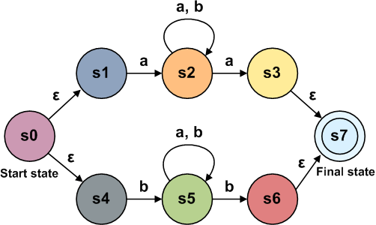
Deterministic Finite Automata
CS-3613 TAFL
Instructor: Hashim Ayub

Slide 2
Deterministic Finite Automata (DFA)
In DFA, given current state, we know what next state will be
In other words, the exact state to which the machine moves can be determined.
It has only one unique state, no choices and randomness
Easy and simple to design
1
– A
B
1
0
0
0
0
1
C
D+
1

Slide 3







Formal Definition
Deterministic Finite Automaton (DFA)
$$M=\left(Q,Σ,δ,q_{0},F\right)$$
$$Q$$
: set of states
$$Σ$$
: input alphabet
$$λ∉Σ$$
$$δ$$
: transition function
$$q_{0}$$
: initial state
$$F$$
: set of accepting states

Slide 4
Deterministic Finite Automaton (DFA)
Input Tape
String
Output
“Accept”
or
“Reject”
Finite
Automaton

Slide 5
















Transition Graph
$$a,b$$
$$Q=\left\{q_{0},q_{1},q_{2},q_{3},q_{4},q_{5}\right\}$$
$$Σ=\left\{a,b\right\}$$
$$q_{5}$$
$$a,b$$
$$b$$
$$a$$
$$b$$
$$a$$
$$q_{0}$$
$$a$$
$$q_{1}$$
$$b$$
$$q_{2}$$
$$b$$
$$q_{3}$$
$$a$$
$$q_{4}$$
initial
state
accepting
state
transition
state

Slide 6
Simulator to try other Examples at Home: jFAST
jFAST is a simple finite automata (FA) graphical simulation utility; it is designed to feature simple mechanisms for creating, editing, and simulating FA. jFAST is ideal for use by students, instructors, and self-guided explorers alike.
https://sourceforge.net/projects/jfast-fsm-sim/

Slide 7
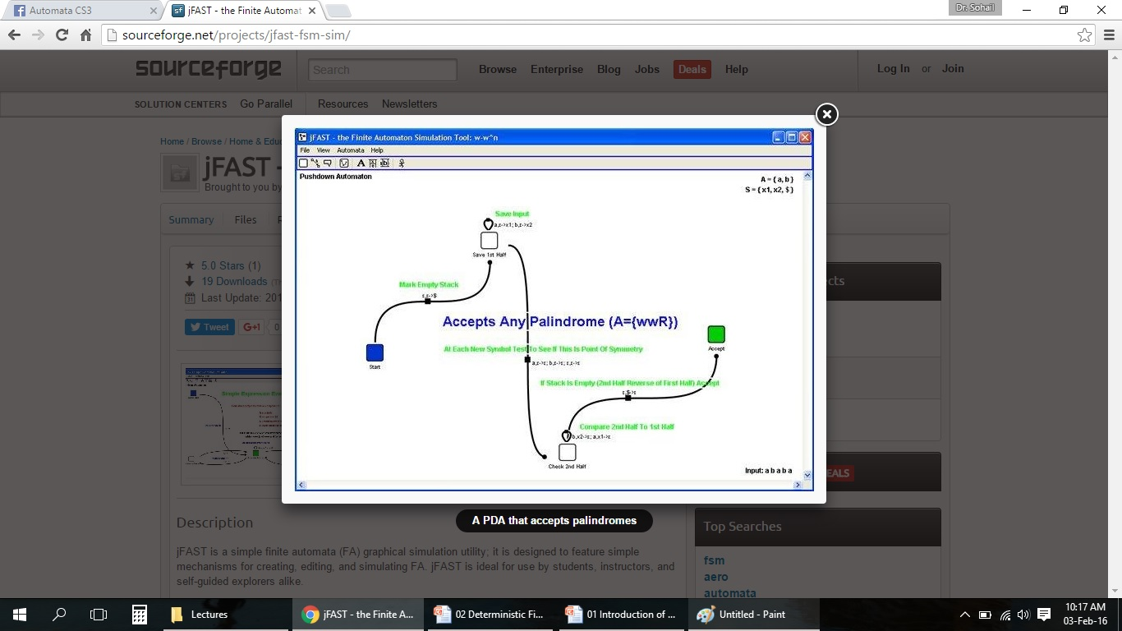
Simulator to try other Examples at Home: jFAST

Slide 8



















Input Alphabet
$$Σ$$
$$λ∉Σ$$
:the input alphabet never contains
$$λ$$
Example
$$Σ=\left\{a,b\right\}$$
$$a,b$$
$$q_{5}$$
$$a,b$$
$$b$$
$$a$$
$$b$$
$$a$$
$$q_{0}$$
$$a$$
$$q_{1}$$
$$b$$
$$q_{2}$$
$$b$$
$$q_{3}$$
$$a$$
$$q_{4}$$

Slide 9











Initial State
$$q_{0}$$
Example
$$a,b$$
$$q_{5}$$
$$a,b$$
$$b$$
$$a$$
$$b$$
$$a$$
$$q_{0}$$
$$a$$
$$q_{1}$$
$$b$$
$$q_{2}$$
$$b$$
$$q_{3}$$
$$a$$
$$q_{4}$$

Slide 10


Set of Accepting States
$$F⊆Q$$
Example
$$F=\left\{q_{4}\right\}$$
$$a,b$$
$$q_{5}$$
$$a,b$$
$$b$$
$$a$$
$$b$$
$$a$$
$$q_{0}$$
$$a$$
$$q_{1}$$
$$b$$
$$q_{2}$$
$$b$$
$$q_{3}$$
$$a$$
$$q_{4}$$

Slide 11


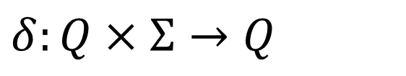
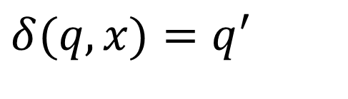


Transition Function
$$δ:Q×Σ→Q$$
$$δ(q,x)=q^{′}$$
$$q$$
$$x$$
$$q^{′}$$
Describes the result of a transition
from state with symbol
$$q$$
$$x$$

Slide 12


Example:
$$δ\left(q_{0},a\right)=q_{1}$$
$$a,b$$
$$q_{5}$$
$$a,b$$
$$b$$
$$a$$
$$b$$
$$a$$
$$q_{0}$$
$$a$$
$$q_{1}$$
$$b$$
$$q_{2}$$
$$b$$
$$q_{3}$$
$$a$$
$$q_{4}$$

Slide 13




$$δ\left(q_{0},b\right)=q_{5}$$
$$a,b$$
$$q_{5}$$
$$a,b$$
$$b$$
$$a$$
$$b$$
$$a$$
$$q_{0}$$
$$a$$
$$q_{1}$$
$$b$$
$$q_{2}$$
$$b$$
$$q_{3}$$
$$a$$
$$q_{4}$$

Slide 14

$$δ\left(q_{2},b\right)=q_{3}$$
$$a,b$$
$$q_{5}$$
$$a,b$$
$$b$$
$$a$$
$$b$$
$$a$$
$$q_{0}$$
$$a$$
$$q_{1}$$
$$b$$
$$q_{2}$$
$$b$$
$$q_{3}$$
$$a$$
$$q_{4}$$

Slide 15



























Transition Table for
$$δ$$
symbols
$$δ$$
$$a$$
$$b$$
$$q_{0}$$
$$q_{1}$$
$$q_{5}$$
$$q_{1}$$
$$q_{5}$$
$$q_{2}$$
states
$$q_{5}$$
$$q_{2}$$
$$q_{3}$$
$$a,b$$
$$q_{3}$$
$$q_{4}$$
$$q_{5}$$
$$q_{4}$$
$$q_{5}$$
$$q_{5}$$
$$q_{5}$$
$$q_{5}$$
$$q_{5}$$
$$q_{5}$$
$$a,b$$
$$b$$
$$a$$
$$a$$
$$b$$
$$q_{0}$$
$$a$$
$$q_{1}$$
$$b$$
$$q_{2}$$
$$b$$
$$q_{3}$$
$$a$$
$$q_{4}$$

Slide 16
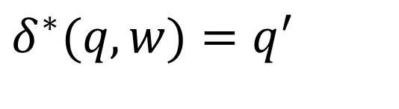
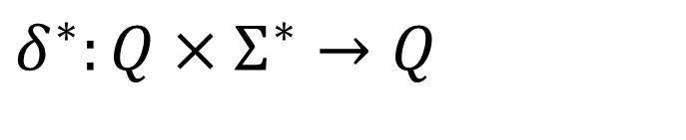


Extended Transition Function
$$δ^{∗}:Q×Σ^{∗}→Q$$
$$δ^{∗}(q,w)=q^{′}$$
Describes the resulting state
after scanning string from state
$$w$$
$$q$$

Slide 17




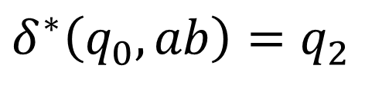








Example:
$$δ^{∗}\left(q_{0},ab\right)=q_{2}$$
$$a,b$$
$$q_{5}$$
$$a,b$$
$$b$$
$$a$$
$$b$$
$$a$$
$$q_{0}$$
$$a$$
$$q_{1}$$
$$b$$
$$q_{2}$$
$$b$$
$$q_{3}$$
$$a$$
$$q_{4}$$

Slide 18





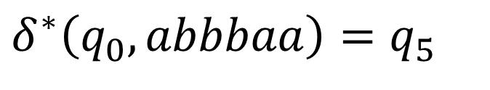








$$δ^{∗}\left(q_{0},abbbaa\right)=q_{5}$$
$$a,b$$
$$q_{5}$$
$$a,b$$
$$b$$
$$a$$
$$b$$
$$a$$
$$q_{0}$$
$$a$$
$$q_{1}$$
$$b$$
$$q_{2}$$
$$b$$
$$q_{3}$$
$$a$$
$$q_{4}$$

Slide 19
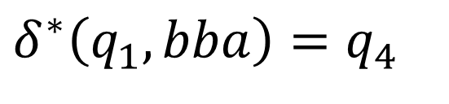
$$δ^{∗}\left(q_{1},bba\right)=q_{4}$$
$$a,b$$
$$q_{5}$$
$$a,b$$
$$b$$
$$a$$
$$b$$
$$a$$
$$q_{0}$$
$$a$$
$$q_{1}$$
$$b$$
$$q_{2}$$
$$b$$
$$q_{3}$$
$$a$$
$$q_{4}$$

Slide 20

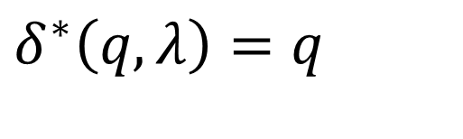
Special case:
for any state
$$q$$
$$δ^{∗}\left(q,λ\right)=q$$

Slide 21
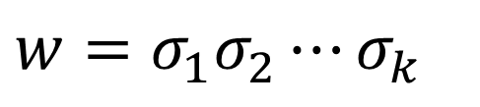


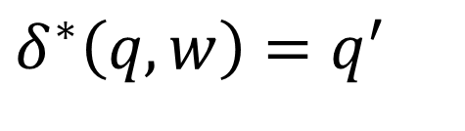






In general:
$$δ^{∗}\left(q,w\right)=q^{′}$$
implies that there is a walk of transitions
$$w=σ_{1}σ_{2}⋯σ_{k}$$
$$σ_{1}$$
$$σ_{2}$$
$$σ_{k}$$
$$q$$
$$q^{′}$$
states may be repeated
$$w$$
$$q$$
$$q^{′}$$

Slide 22

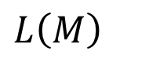
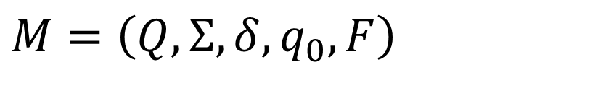

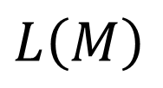
Language Accepted by DFA
Language L accepted by DFA machine M
is denoted as and contains all the strings accepted by
$$L\left(M\right)$$
$$M$$
We also say that recognizes
$$L\left(M\right)$$
$$M$$
$$M=\left(Q,Σ,δ,q_{0},F\right)$$
A word w is a string of letters from alphabets (Σ) in a linear sequence. eg. 0110 that is taken from Σ.
|w| denotes the length of word w.

Slide 23



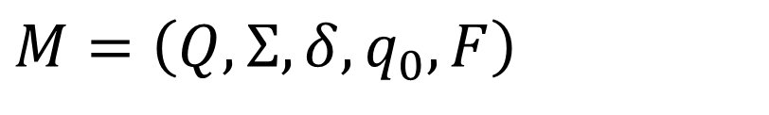


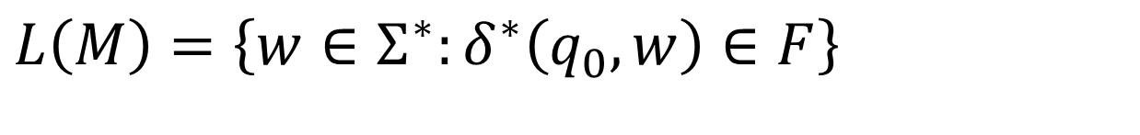
For a DFA
Language accepted by :
$$M=\left(Q,Σ,δ,q_{0},F\right)$$
$$M$$
$$L\left(M\right)=\left\{w∈Σ^{∗}:δ^{∗}\left(q_{0},w\right)∈F\right\}$$
$$w$$
$$q_{0}$$
$$q^{′}$$
$$q^{′}∈F$$

Slide 24


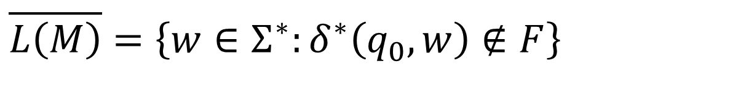

Language rejected by :
$$M$$
$$\overline{L\left(M\right)}=\left\{w∈Σ^{∗}:δ^{∗}\left(q_{0},w\right)∉F\right\}$$
$$w$$
$$q_{0}$$
$$q^{′}$$
$$q^{′}∉F$$

Slide 25
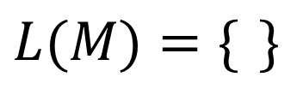


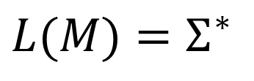

DFA Examples
$$Σ=\{a,b\}$$
$$a,b$$
$$a,b$$
$$q_{0}$$
$$q_{0}$$
$$L(M)=\{ \}$$
$$L(M)=Σ^{∗}$$
Empty language
All strings

Slide 26
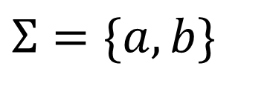






$$Σ=\{a,b\}$$
$$L\left(M\right)$$
= { all strings with prefix }
$$ab$$
$$a,b$$
$$q_{0}$$
$$a$$
$$q_{1}$$
$$b$$
$$q_{2}$$
accept
$$b$$
$$a$$
$$q_{3}$$
$$a,b$$

Slide 27











$$L\left(M\right)$$
= { all binary strings containing
substring }
$$001$$
$$0,1$$
$$1$$
$$0$$
$$1$$
$$0$$
$$1$$
$$λ$$
$$0$$
$$00$$
$$001$$
$$0$$

Slide 28

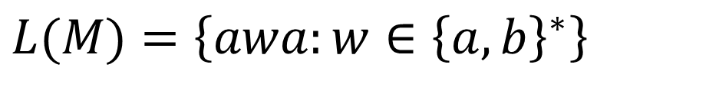

$$L(M)=\left\{awa:w∈{\left\{a,b\right\}}^{∗}\right\}$$
$$a$$
$$b$$
$$b$$
$$q_{0}$$
$$a$$
$$q_{2}$$
$$q_{3}$$
$$b$$
$$a$$
$$q_{4}$$
$$a,b$$

